Slide 1
Lecture-07

Slide 2
Contents
Source Control Management
Types of Version Control System
Version Control Tools
What is Git
Features of Git
GitHub
Features of GitHub

Slide 3
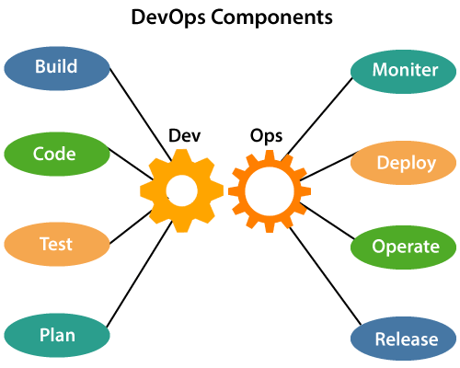
DevOps Components

Slide 4
Source Code Management
Source code management (SCM) is used to track modifications to a source code repository.
SCM tracks a running history of changes to a code base and helps resolve conflicts when merging updates from multiple contributors.
SCM is also synonymous with Version control.

Slide 5
Types of Version Control System
Localized version Control System
Centralized version control systems
Distributed version control systems

Slide 6
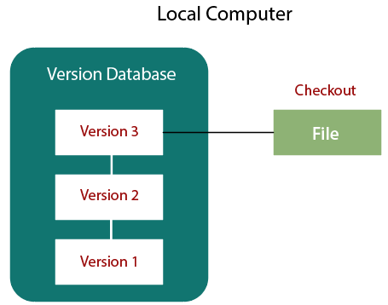
Localized version Control System

Slide 7
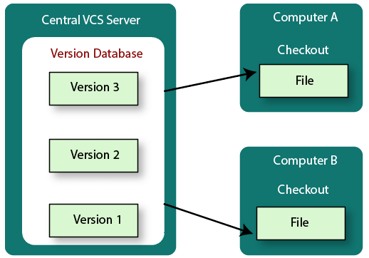
Centralized Version Control System

Slide 8
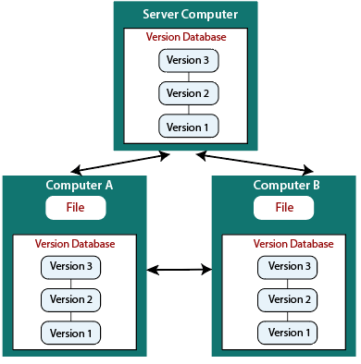
Distributed Version Control System
In a Distributed Version Control System (such as Git, Mercurial, Bazaar or Darcs), the user has a local copy of a repository. The local repository contains all the files and metadata present in the main repository.

Slide 9
Centralized Version Control System VS Distributed Version Control System
Centralized Version Control System | Distributed Version Control System
In CVCS, The repository is placed at one place and delivers information to many clients. | In DVCS, Every user has a local copy of the repository in place of the central repository on the server-side.
It is based on the client-server approach. | It is based on the client-server approach.
It is the most straightforward system based on the concept of the central repository. | It is flexible and has emerged with the concept that everyone has their repository.
In CVCS, the server provides the latest code to all the clients across the globe. | In DVCS, every user can check out the snapshot of the code, and they can fully mirror the central repository.

Slide 10
Centralized Version Control System VS Distributed Version Control System (Cont.)
Centralized Version Control System | Distributed Version Control System
CVCS is easy to administrate and has additional control over users and access by its server from one place. | DVCS is fast comparing to CVCS as you don't have to interact with the central server for every command.
The popular tools of CVCS are SVN (Subversion) and CVS. | The popular tools of DVCS are Git and Mercurial.
CVCS is easy to understand for beginners. | DVCS has some complex process for beginners.
If the server fails, No system can access data from another system. | if any server fails and other systems were collaborating via it, that server can restore any of the client repositories

Slide 11
Version Control Tools
Best version control/revision control tools:
  Git
  Mercurial
  Monotone

Slide 12
What is Git
Git is an open-source distributed version control system.
It is designed to handle minor to major projects with high speed and efficiency.
It is developed to co-ordinate the work among the developers.
Version control allows developers to track and work together with team members at the same workspace.

Slide 13
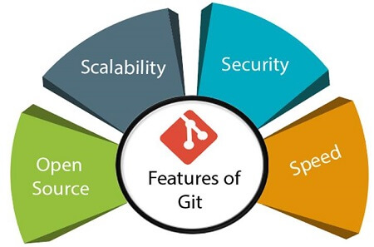
Features of Git
Features of Git

Slide 14
Features of Git (Cont.)
Open Source
  Git is an open-source tool. It is released under the GPL (General Public License) license.
Scalable
  Git is scalable, which means when the number of users increases, the Git can easily handle such situations.

Slide 15
Features of Git (Cont.)
Distributed
  Distributed means that instead of switching the project to another machine, developer can create a "clone" of the entire repository. Also, instead of just having one central repository that you send changes to, every user has their own repository that contains the entire commit history of the project. Developer do not need to connect to the remote repository; the change is just stored on the local repository. If necessary, we can push these changes to a remote repository.

Slide 16
Features of Git (Cont.)
Security
  Git is secure. It uses the SHA1 (Secure Hash Function) to name and identify objects within its repository. Files and commits are checked and retrieved by its checksum at the time of checkout.
  Once it is published, one cannot make changes to its old version.
Speed
  Git is very fast, so it can complete all the tasks in a while. Most of the git operations are done on the local repository, so it provides a huge speed. Also, a centralized version control system continually communicates with a server somewhere.

Slide 17
Git Staging Area
Staging Area
  The Staging area is also a unique functionality of Git. It can be considered as a preview of our next commit, moreover, an intermediate area where commits can be formatted and reviewed before completion. When you make a commit, Git takes changes that are in the staging area and make them as a new commit. We are allowed to add and remove changes from the staging area.

Slide 18
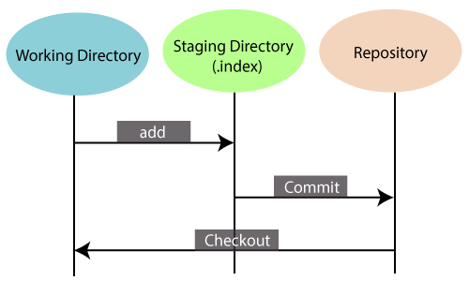
Git Staging Area (Cont.)
Staging Area

Slide 19
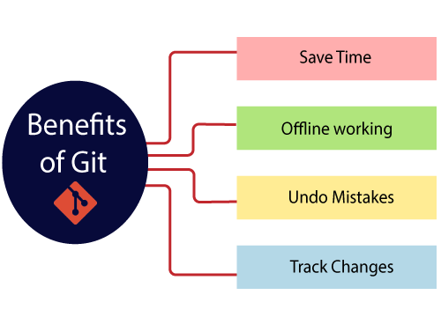
Benefits of Git
Significant benefits

Slide 20
Benefits of Git (Cont.)
Saves Time
  Git is lightning fast technology. Each command takes only a few seconds to execute so we can save a lot of time as compared to login to a GitHub account and find out its features.
Offline Working
  One of the most important benefits of Git is that it supports offline working. If we are facing internet connectivity issues, it will not affect our work. In Git, we can do almost everything locally. Comparatively, other CVS like SVN is limited and prefer the connection with the central repository.
Undo Mistakes
  One additional benefit of Git is we can Undo mistakes. Sometimes the undo can be a savior option for us. Git provides the undo option for almost everything.
Track the Changes
  Git facilitates with some exciting features such as Diff, Log, and Status, which allows us to track changes so we can check the status, compare our files or branches

Slide 21
GitHub
GitHub is a Git repository hosting service. GitHub also facilitates with many of its features, such as access control and collaboration. It provides a Web-based graphical interface.
It offers both distributed version control and source code management (SCM) functionality of Git.

Slide 22
Features of GitHub
GitHub significant features.
  Collaboration
  Integrated issue and bug tracking
  Graphical representation of branches
  Git repositories hosting
  Project management
  Team management
  Code hosting
  Track and assign tasks
  Conversations

Slide 23
Thanks
…?

